Slide 1

Work From Home Has COVID-19 Impacted People’s Attitudes and Thoughts
IST736 TEXT MINING
GROUP TWO
Antonio Luina
Bhavya K Madhavan
Daphne Chang
Tamilselvan Tamilmani
March 2021
Notes:
Group 2's topic is: Work From Home: Has the COVID-19 Pandemic Impacted on People's Attitudes and Thoughts about Working from home.
[Next Slide]

Slide 2
Agenda
Introduction
How do people feel about working from home?
What's on people's minds when talking about working from home?
Data Sources
Notes:
The presentation today will first introduce the background of the study; the business issue to resolve. The data sources used in the study will be explained. Then, the findings of the study will be presented. The first set of findings focuses on how people feel about working from home. The 2nd set of findings shows what else people are thinking when talking about working from home.
[Next Slide]

Slide 3
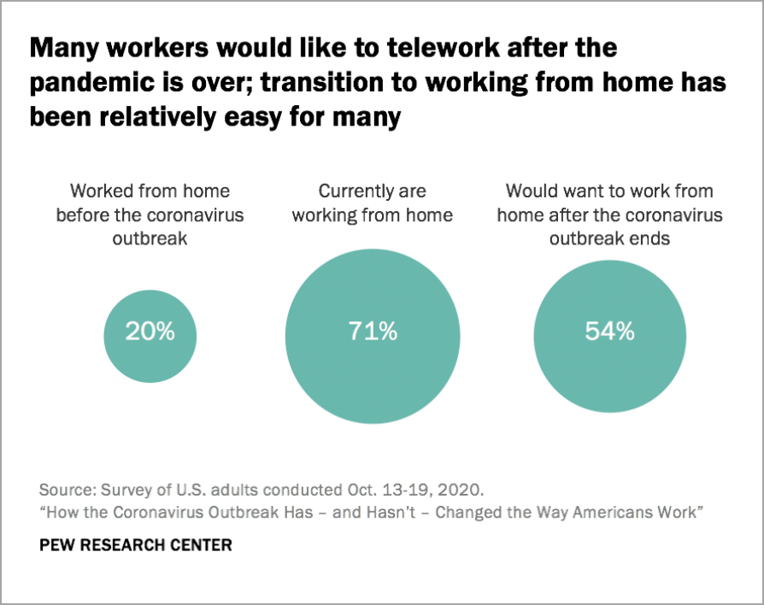
Introduction
Notes:
Working from home is not new. According to a survey conducted by the Pew Research Center in October 2020, 20% of employees worked from home before the pandemic. By October 2020, 70% of employees worked from home. Many of them found the transition to working from home relatively easy. 54% of employees would like to continue working from home after the pandemic ends.
[Next Slide]

Slide 4

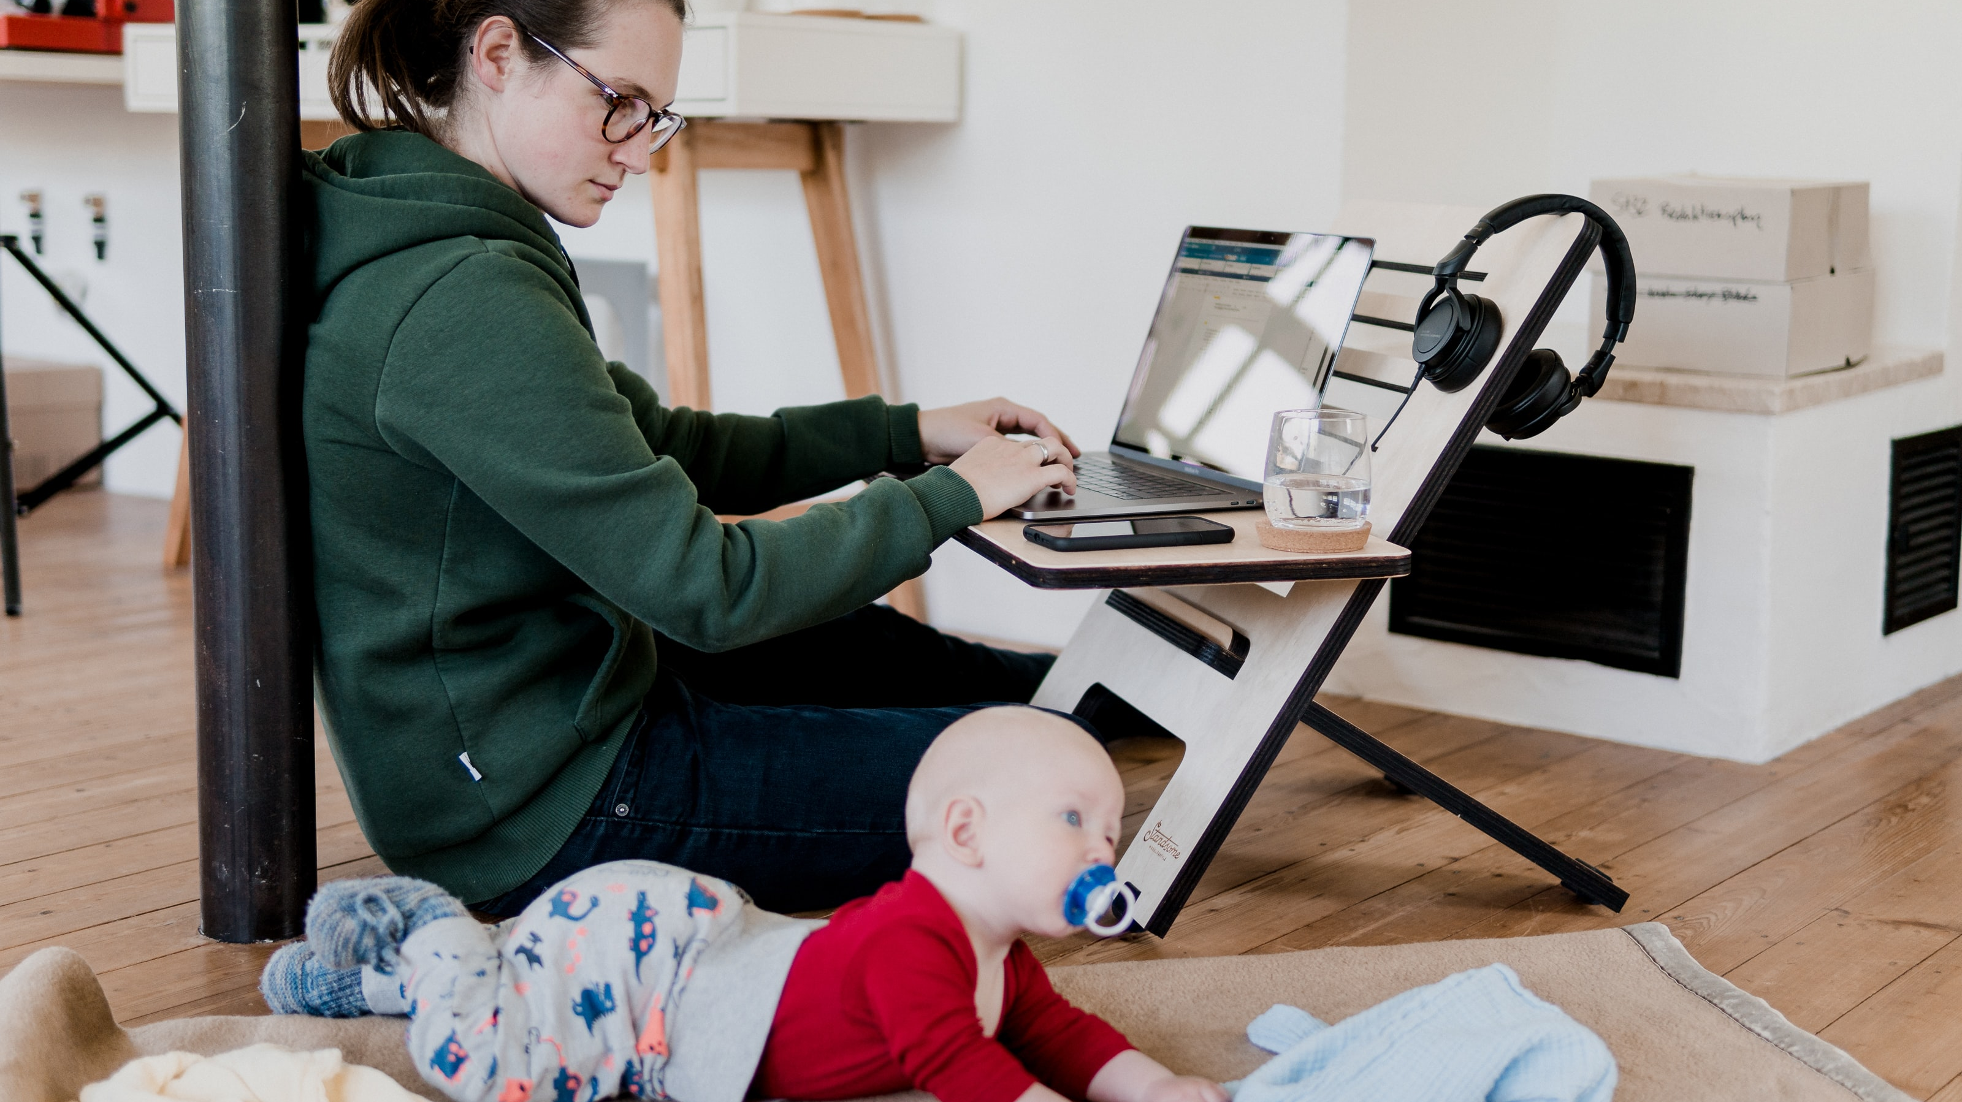


Big Business USA
Notes:
At the company Big Business USA, 90% of the workforce from business locations across the country have been working from home since April 2020. Many of them now ask if they could continue to work from home after the pandemic. In response, the HR department needs to come up with a work-from-home strategy.
[Next Slide]

Slide 5
The HR Department Wants to Know
How people feel?
Has COVID-19 impacted people's attitudes and thoughts?
What is on people’s minds?
Notes:
As the first step, the HR department wants to know
how people feel about working from home – has the pandemic changed how they feel?
Comparing how people feel before and after the start of the pandemic will help the department understand if there is indeed a changing trend in people's remote work preferences in society, so employees' voices are not isolated cases.
what else is on people’s minds when they talk about working from home – has the pandemic changed what’s their minds?
Getting to know what is on people’s minds when talking about working from home will help shed some light on what people have coped with when working from home, and if the pandemic has impacted the extent of things they have to cope with.
[For the next few slides, Bhavya will talk about the data sources used in the study.]

Slide 6
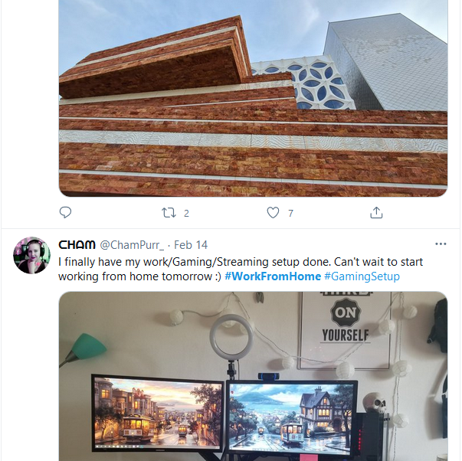
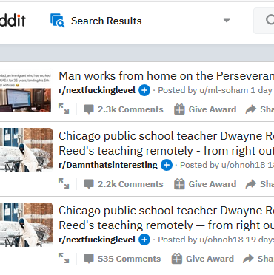


Data Sources

Slide 7
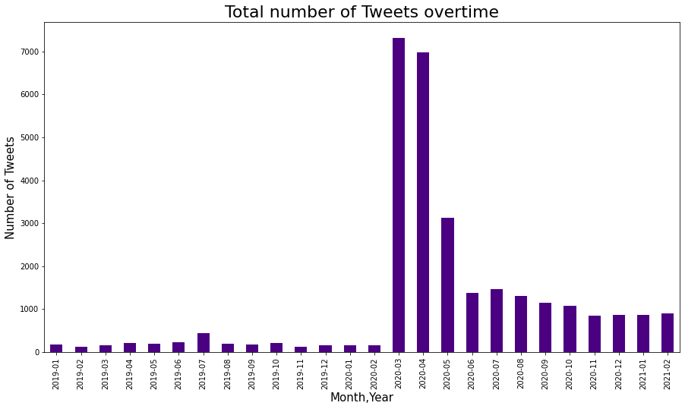
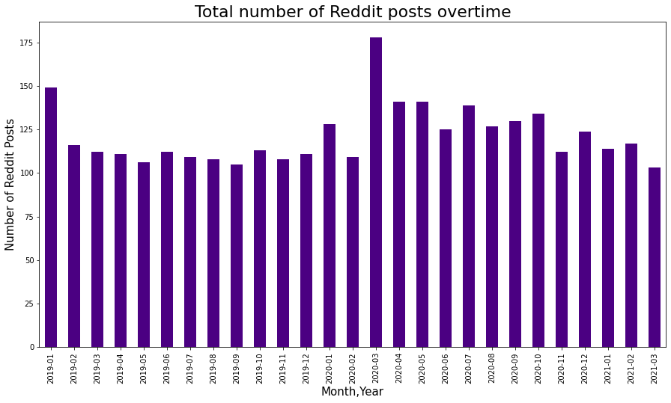
About the Data
Twitter
Reddit

Slide 8
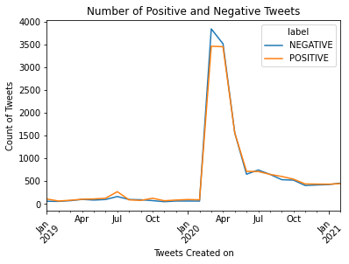
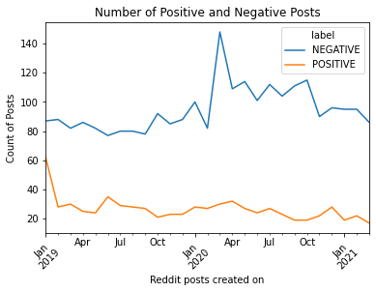
About the Data
Twitter
Reddit

Slide 9
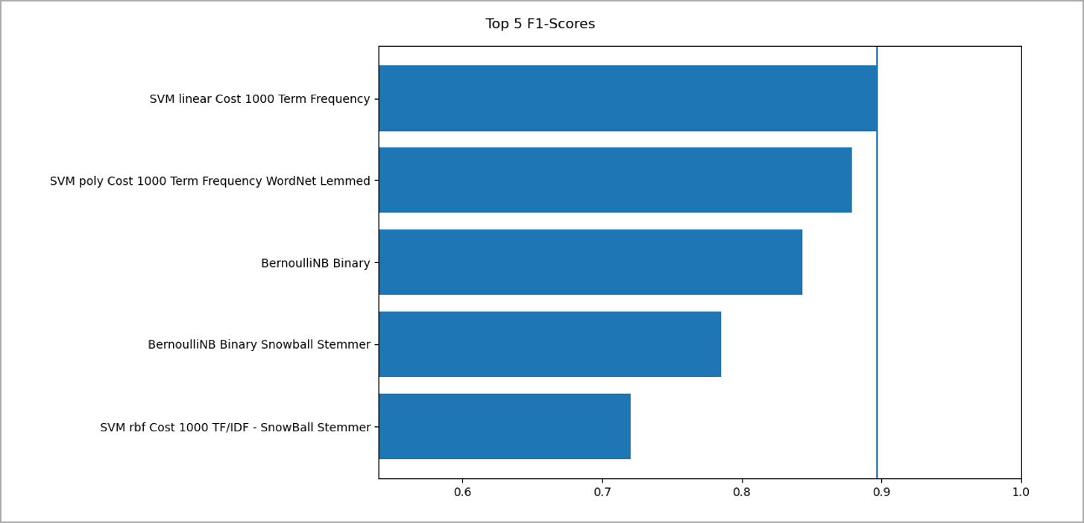
How do people feel?
Notes:
One of the goals is to be aware of how people feel about working from home. To accomplish this, a sentiment analysis was done on the 30k posts by training 136 models and then picking the best.
30k posts for running 136 models was to much for the time and computing power available. To compensate, the models were trained using a sampling of five thousand balanced records. Transformer Sentiment analysis was used to label the 5 thousand records and then the 136 models used the sampled set to train. The Top 5 F1-Scores were selected, and SVM with a linear kernel with a cost of 1,000 using the Term Frequency Vectorizer gave the highest score. What does that mean? That means that 30k posts can be passed through the selected model and answer the question, How do people feel about working from home?

Slide 10
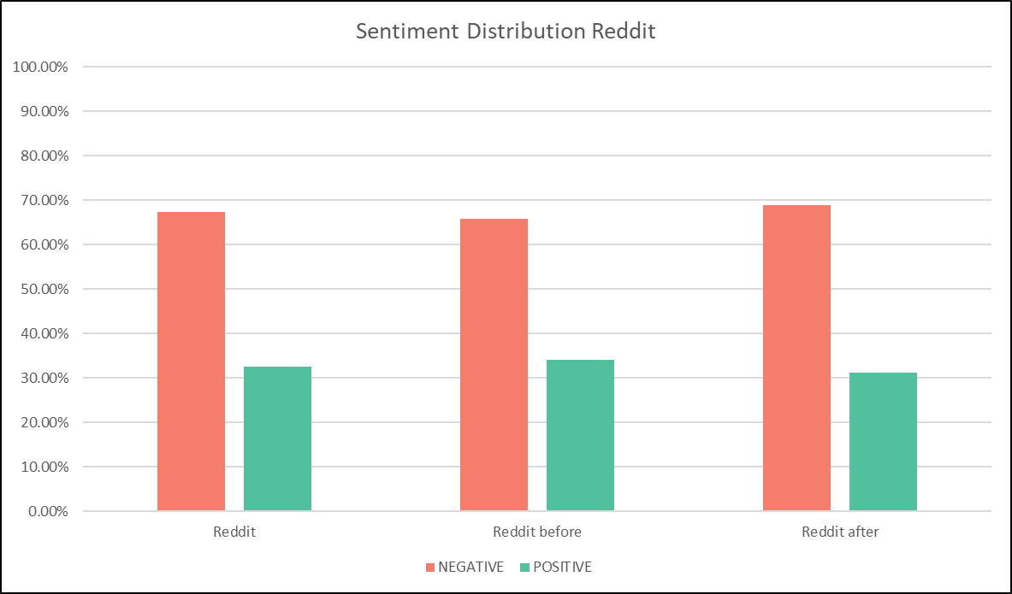
How do people feel?
3282 Records
1597 Records
1685 Records
Notes:
Let’s start with Reddit, which was about 10 percent of the data. Reddit, was mostly negative, the amount of posts didn’t go up much after the pandemic started and the percentage of negatives went up.

Slide 11
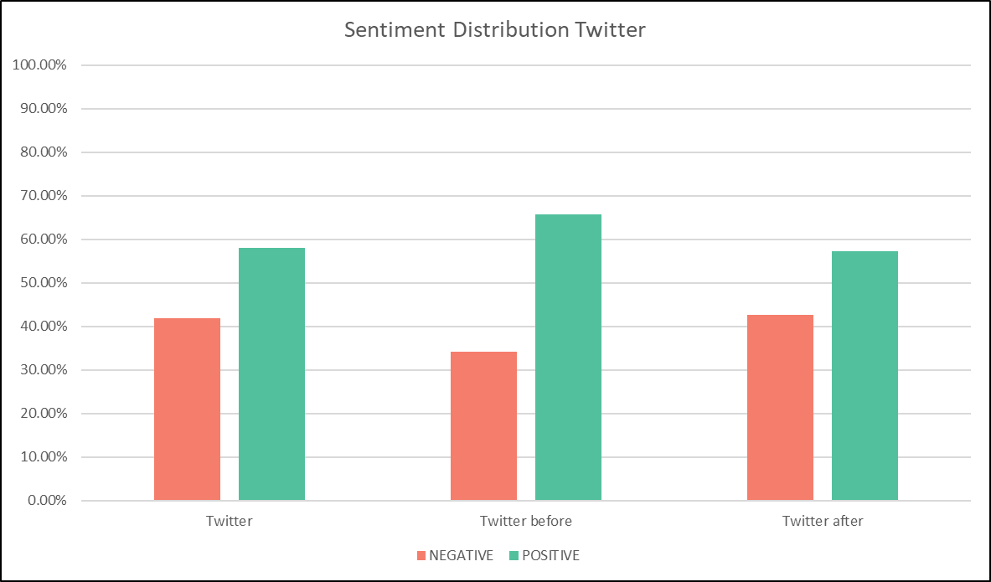
How do people feel?
29550 Records
2664 Records
26886 Records
Notes:
For twitter posts, it was different, the number of records went up 10 times and the sentiment were more positive compared to reddit. The change from before to after it was less positive than the “before”.

Slide 12
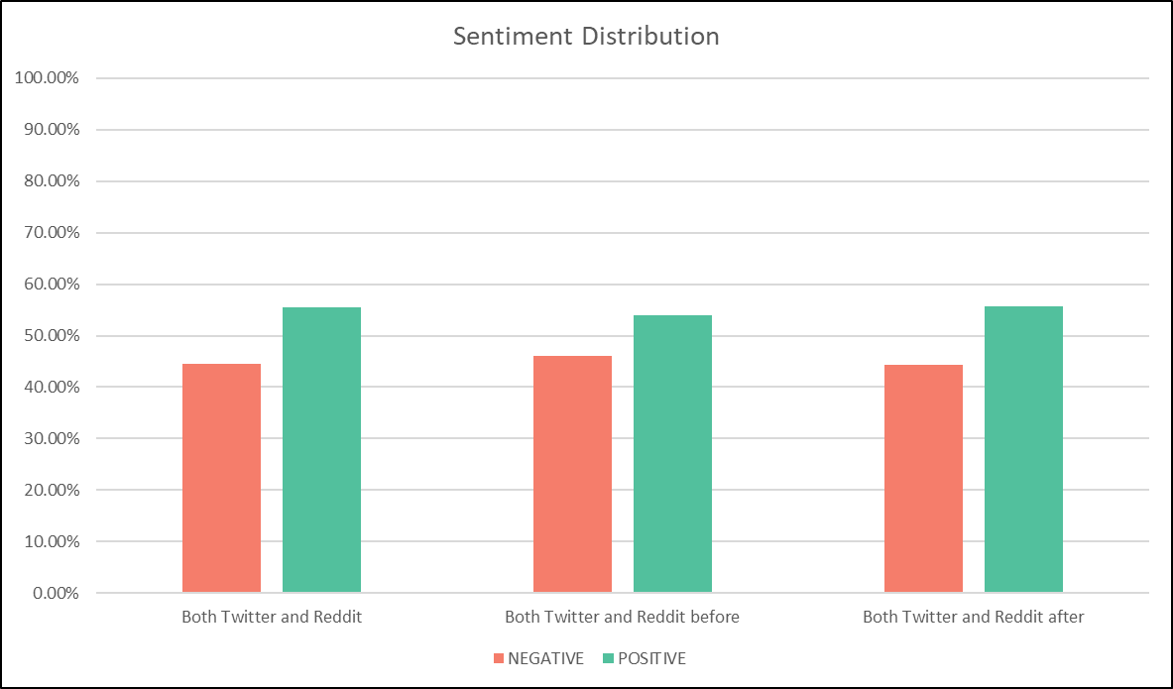
How do people feel?
32832 Records
4261 Records
28571 Records
Notes:
When combined, both reddit and twitter, since there were so many records, the differences are not that noticeable. The overall result is, that most posts are positive, about 55%, which aligns with the percentage of people that would like to continue working from home after the pandemic is over, and number of positive posts goes up from before and after.
To answer the question, for the time period selected, people are feeling positive when talking about working from home.
That was the sentiment analysis, now I’ll leave you with Tamil.

Slide 13
What's on People's Minds?
Notes:
Tamil

Slide 14
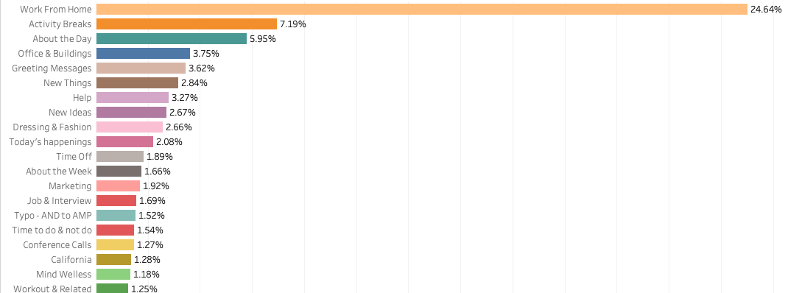
What's on People's Minds?
Before
After
Notes:
Tamil

Slide 15
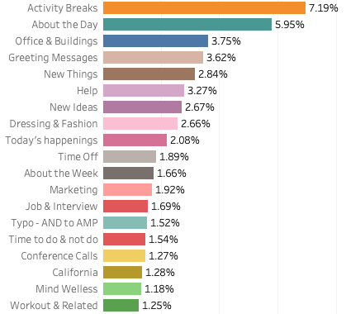
Notes:
Tamil

Slide 16
What people are doing during work from home?
Notes:
Tamil

Slide 17
Conclusion
More positive sentiments after COVID-19 started
Activity Breaks. About the Day. Office & Buildings. Greeting Messages. New Things. Help. New Ideas.
Notes:
The study analyzed the postings on two popular social media sites, Reddit and Twitter, from about one year before the pandemic to one year after the start of the pandemic.The findings show a slight change in people's attitudes from negative to positive after the beginning of the pandemic.
As for what's on people's minds when they talk about working from home, before the pandemic most talk was pretty much about work. However, after the pandemic started, more topics emerged.
The top-ranking topics are: activity breaks, about the day, office & buildings, greeting messages, new things, help, and new ideas.
A limitation of the current study is that 90% of the data analyzed was from Twitter. It is recommended that more data sources, such as Facebook and LinkedIn, be included in the next stage of the study.
Also, It is recommended that Big Business U.S.A. implement an automated system to continue to observe people's sentiments and thoughts. The company could consider setting up an internal company social media site. Employees' postings can then be analyzed using the methods provided by the study.

Slide 18
Thank You
Notes:
Tamil

